Slide 1

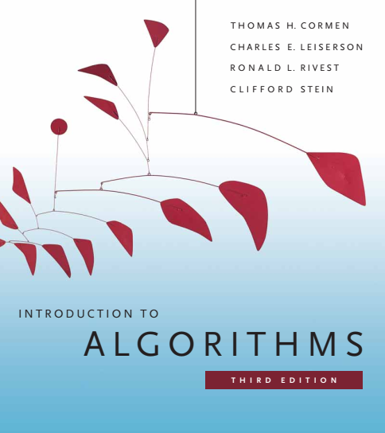
Design and Analysis of Algorithms
Dr. Sajid Iqbal
sajidiqbal.pk@gmail.com
Reference Book
Introduction to Algorithms 3rd Edition By Thomas H. Cormen et. al.
https://mitpress.mit.edu/books/introduction-algorithms-third-edition
COMEDXD

Slide 2
The Maximum Subarray Problem (MSP)
An application of divide and conquer

Slide 3
Background
Break the problem into a number of subproblems that are smaller instances of the same problem
Conquer
Solve the sub-problems recursively. Solve the smallest problems directly
Combine
Combine the solutions to the subproblems into the solution for the original problem
Divide
Divide-n-Conquer consists of three phases
A recurrence is an equation or inequality that describes a function in terms of its value on smaller inputs.

Slide 4
Example – Stock Trading
Let you are interested in trading shares of a company
You can buy one unit of stock only one time and then sell it at a later date and can learn what the price of the stock will be in the future.
The goal is to maximize your profit by using “buy low and sell high” principle
Within a given period, you might not be able to buy at the lowest price and then sell at the highest price

Slide 5
Share Price Details
we can maximize profit by buying at the lowest price, after day 7.
We will find the lowest price point (LPP) and highest price point (HPP)
The pair (LPP, HPP) will give us maximum profit
Counter Example shows that day (2,3) gives maximum profit however
Price on day is neither lowest nor price at day 3 is highest
Day | 0 | 1 | 2 | 3 | 4
Price | 10 | 11 | 7 | 10 | 6
Change |  | 13 | -3 | -25 | 20
Day | 0 | 1 | 2 | 3 | 4 | 5 | 6 | 7 | 8 | 9 | 10 | 11 | 12 | 13 | 14 | 15 | 16
Price | 100 | 113 | 110 | 85 | 105 | 102 | 86 | 63 | 81 | 101 | 94 | 106 | 101 | 79 | 94 | 90 | 97
Change |  | 13 | -3 | -25 | 20 | -3 | -16 | -23 | 18 | 20 | -7 | 12 | -5 | -22 | 15 | -4 | 7

Slide 6

A brute-force solution
Try every possible pair of buy and sell dates in which the buy date precedes the sell date
A period of n-days has $\left(\begin{matrix}n \\ 2\end{matrix}\right)=\frac{n!}{\left(2!\right)\left(n−2\right)!}$ pairs. It has time complexity $θ(n^{2})$
$\left(\begin{matrix}5 \\ 2\end{matrix}\right)=\frac{5!}{\left(2!\right)\left(5−2\right)!}=\frac{5!}{2!∗3!}=\frac{5∗4}{2}=10 →\{\left(1,2\right),\left(1,3\right),\left(1,4\right),\left(1,5\right),\left(2,3\right),\left(2,4\right),\left(2,5\right),\left(3,4\right),\left(3,5\right),(4,5)$
we can hope to evaluate each pair of dates in constant time,
this approach would take $Ω(n^{2})$ time

Slide 7

A transformation
Find the sequence of days over which the net change from the first day to the last is maximum.
Instead of looking at the daily prices, we consider the daily change in price
The change on day $i$ is the difference between the prices after day $i − 1$ and after day $i$.
Maximum subarray: Find the nonempty, contiguous subarray of A ( last row of table) whose values have the largest sum.
In our example, Maximum Sub-Array is A[8-11] with sum=43
Thus, buy the stock just before day 8 (after day 7) and sell it after day 11, earning a profit of $43 per share.
There could be multiple sub-arrays with same profit
Day | 0 | 1 | 2 | 3 | 4 | 5 | 6 | 7 | 8 | 9 | 10 | 11 | 12 | 13 | 14 | 15 | 16
Price | 100 | 113 | 110 | 85 | 105 | 102 | 86 | 63 | 81 | 101 | 94 | 106 | 101 | 79 | 94 | 90 | 97
Change |  | 13 | -3 | -25 | 20 | -3 | -16 | -23 | 18 | 20 | -7 | 12 | -5 | -22 | 15 | -4 | 7

Slide 8
Divide and Conquer Solution of Problem

Slide 9

Maximum Sub-Array (MSA) Problem
Divide the subarray into two subarrays of as equal size as possible
$L[low,…,mid], R[mid+1,…,high]$
Let $MSA[i,….j]$be a maximum sub-array, it can now lie
In $L[low,…,mid]$such that $low≤i≤j≤mid$
In $R[mid+1,…,high]$such that $mid+1≤i≤j≤high$
Crossing the mid-point such that $low≤i≤mid<j≤high$
MSA will have maximum sum over all sub-arrays of $L,R$ or crossing over
low |  |  |  |  | mid
Mid+1 |  |  |  |  | high
i |  |  | j
i |  |  | j
i |  |  | j

Slide 10

Solving MSA
Sub-Arrays $L,R$ can be solved recursively
How to solve cross-over MSA
Any subarray crossing the midpoint is itself made of two subarrays
$MSA[i,…,mid], MSA[mid+1,…,j]$
So find these and combine them
Hence the problem is solved using two sub-routines
$FIND_MAXIMUM_SUBARRAY(A, low, high)$
$FIND_MAX_CROSSING_SUBARRAY(A, low, mid, high)$

Slide 11
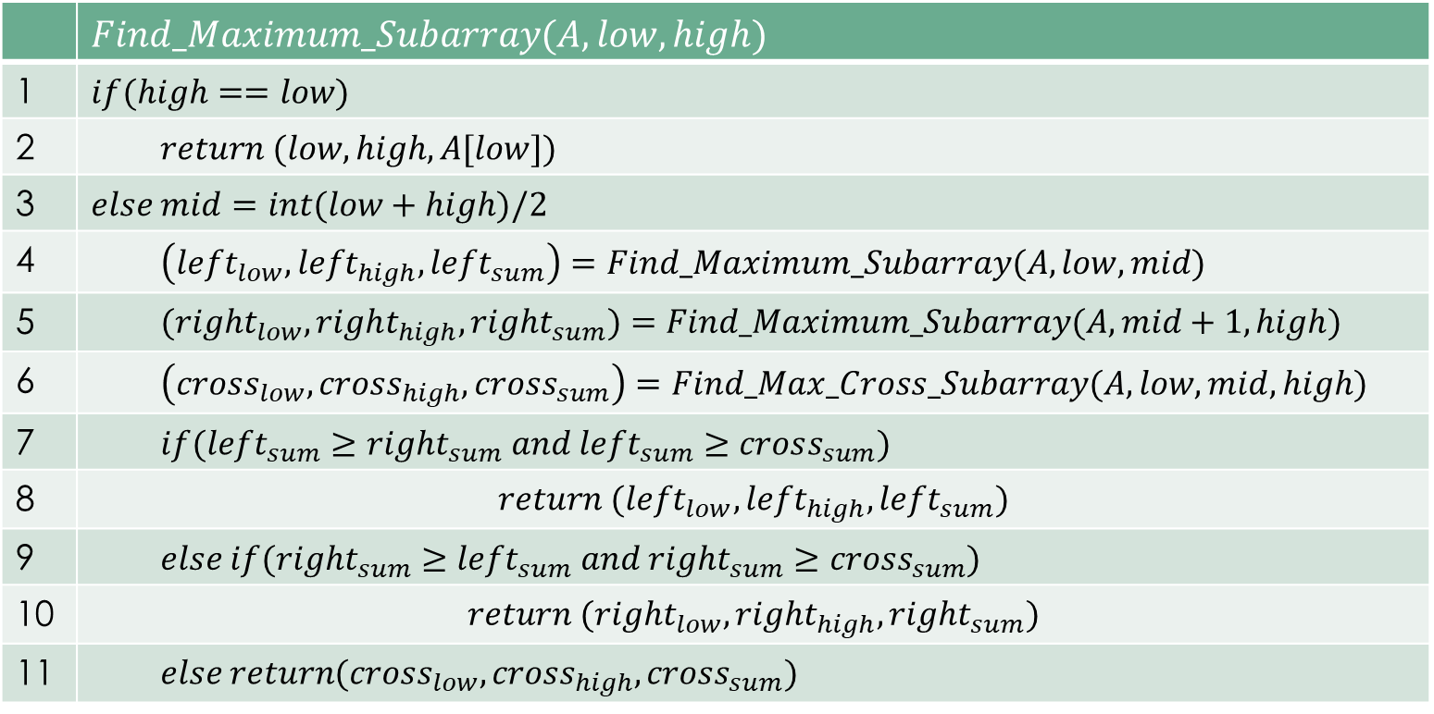
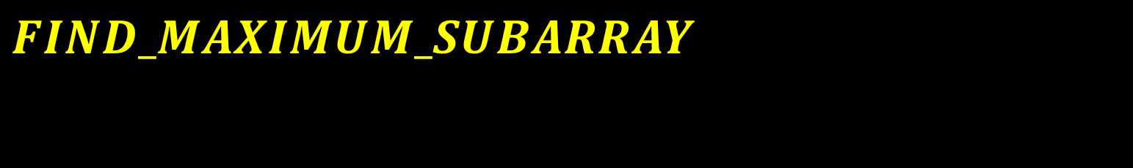
$$FIND_MAXIMUM_SUBARRAY$$
 | $$Find_Maximum_Subarray(A,low,high)$$
1 | $$if(high==low)$$
2 | $$return (low,high, A[low])$$
3 | $$else mid=int(low+high)/2$$
4 | $$\left(left_{low},left_{high},left_{sum}\right)=Find_Maximum_Subarray(A,low,mid)$$
5 | $$(right_{low},right_{high},right_{sum})=Find_Maximum_Subarray(A,mid+1,high)$$
6 | $$\left(cross_{low},cross_{high}, cross_{sum}\right)=Find_Max_Cross_Subarray(A,low,mid,high)$$
7 | $$if(left_{sum}≥right_{sum} and left_{sum}≥cross_{sum})$$
8 | $$return (left_{low},left_{high},left_{sum})$$
9 | $$else if(right_{sum}≥left_{sum} and right_{sum}≥cross_{sum})$$
10 | $$return (right_{low},right_{high},right_{sum})$$
11 | $$else return(cross_{low},cross_{high}, cross_{sum})$$

Slide 12
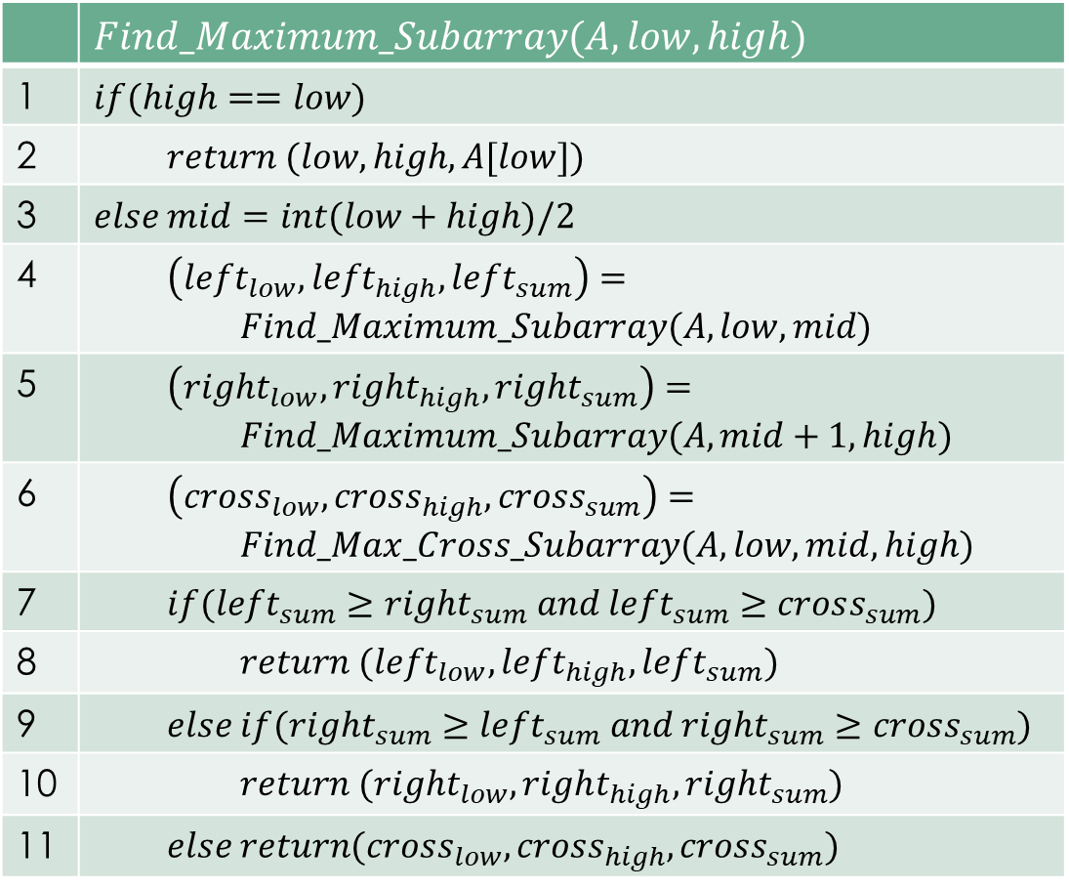
Find_Max_Subarray Procedure
Direct Solution (Non Recursive): Base case
Line 1,2 : if there is only one element
So return that element with low and high indexes
Lines 3–11 handle the recursive case.
Line 3: It computes the mid point of the array
Lines 4 and 5: These lines conquer by recursively finding MSA within the left and right subarrays, respectively.
Lines 6–11: form the combine part.
Line 6 : finds a MSA that crosses the midpoint.
Line 7: tests whether the left subarray contains an MSA
line 8: returns that MSA.
line 9: tests whether the right subarray contains an MSA
line 10: returns that MSA.
line 11: returns the MSA that crosses the mid point

Slide 13
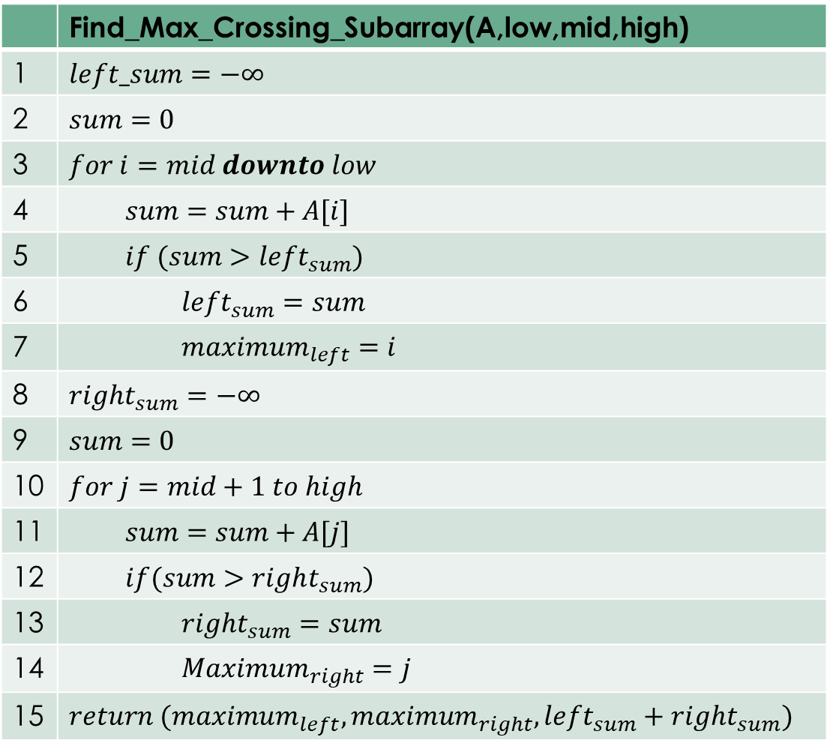
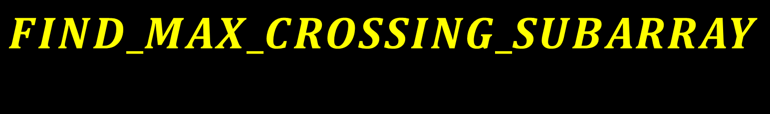
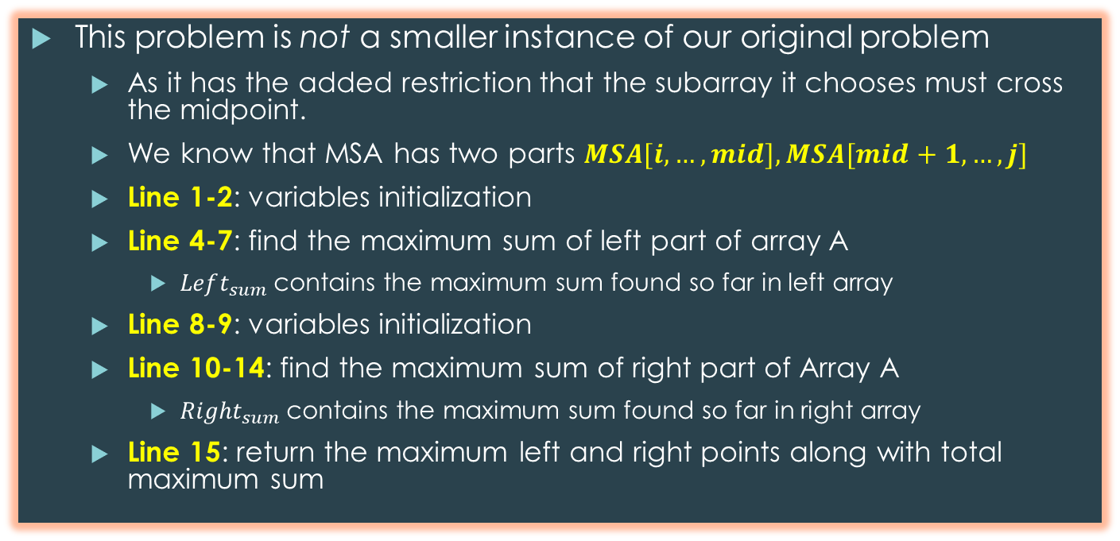
$$FIND_MAX_CROSSING_SUBARRAY$$
 | Find_Max_Crossing_Subarray(A,low,mid,high)
1 | $$left_sum=−∞$$
2 | $$sum=0$$
3 | $$for i=mid downto low$$
4 | $$sum=sum+A[i]$$
5 | $$if (sum>left_{sum})$$
6 | $$left_{sum}=sum$$
7 | $$maximum_{left}=i$$
8 | $$right_{sum}=−∞$$
9 | $$sum=0$$
10 | $$for j=mid+1 to high$$
11 | $$sum=sum+A[j]$$
12 | $$if(sum>right_{sum})$$
13 | $$right_{sum}=sum$$
14 | $$Maximum_{right}=j$$
15 | $$return (maximum_{left},maximum_{right},left_{sum}+right_{sum})$$
This problem is not a smaller instance of our original problem
As it has the added restriction that the subarray it chooses must cross the midpoint.
We know that MSA has two parts $MSA[i,…,mid], MSA[mid+1,…,j]$
Line 1-2: variables initialization
Line 4-7: find the maximum sum of left part of array A
$Left_{sum}$contains the maximum sum found so far in left array
Line 8-9: variables initialization
Line 10-14: find the maximum sum of right part of Array A
$Right_{sum}$contains the maximum sum found so far in right array
Line 15: return the maximum left and right points along with total maximum sum
Change |  | 13 | -3 | -25 | 20 | -3 | -16 | -23 | 18 | 20 | -7 | 12 | -5 | -22 | 15 | -4 | 7

Slide 14
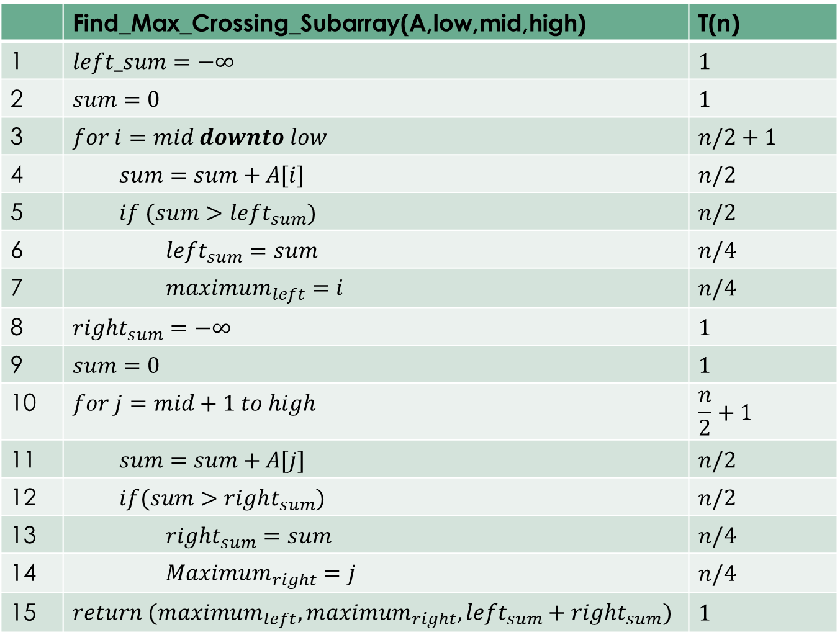
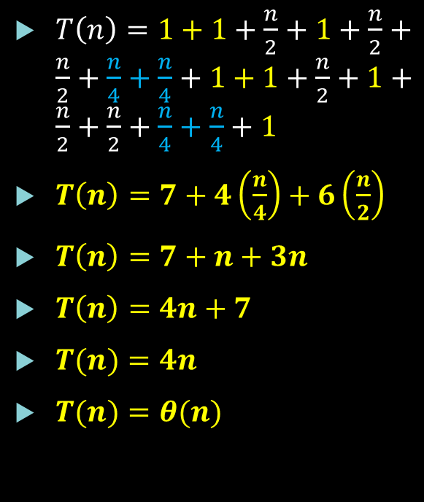
Algorithm Time Complexity
 | Find_Max_Crossing_Subarray(A,low,mid,high) | T(n)
1 | $$left_sum=−∞$$ | $$1$$
2 | $$sum=0$$ | $$1$$
3 | $$for i=mid downto low$$ | $$n/2+1$$
4 | $$sum=sum+A[i]$$ | $$n/2$$
5 | $$if (sum>left_{sum})$$ | $$n/2$$
6 | $$left_{sum}=sum$$ | $$n/4$$
7 | $$maximum_{left}=i$$ | $$n/4$$
8 | $$right_{sum}=−∞$$ | $$1$$
9 | $$sum=0$$ | $$1$$
10 | $$for j=mid+1 to high$$ | $$\frac{n}{2}+1$$
11 | $$sum=sum+A[j]$$ | $$n/2$$
12 | $$if(sum>right_{sum})$$ | $$n/2$$
13 | $$right_{sum}=sum$$ | $$n/4$$
14 | $$Maximum_{right}=j$$ | $$n/4$$
15 | $$return (maximum_{left},maximum_{right},left_{sum}+right_{sum})$$ | $$1$$
$T\left(n\right)=1+1+\frac{n}{2}+1+\frac{n}{2}+\frac{n}{2}+\frac{n}{4}+\frac{n}{4}+1+1+\frac{n}{2}+1+\frac{n}{2}+\frac{n}{2}+\frac{n}{4}+\frac{n}{4}+1$
$T\left(n\right)=7+4\left(\frac{n}{4}\right)+6\left(\frac{n}{2}\right)$
$T\left(n\right)=7+n+3n$
$T\left(n\right)=4n+7$
$T(n)=4n$
$T(n)=θ(n)$

Slide 15
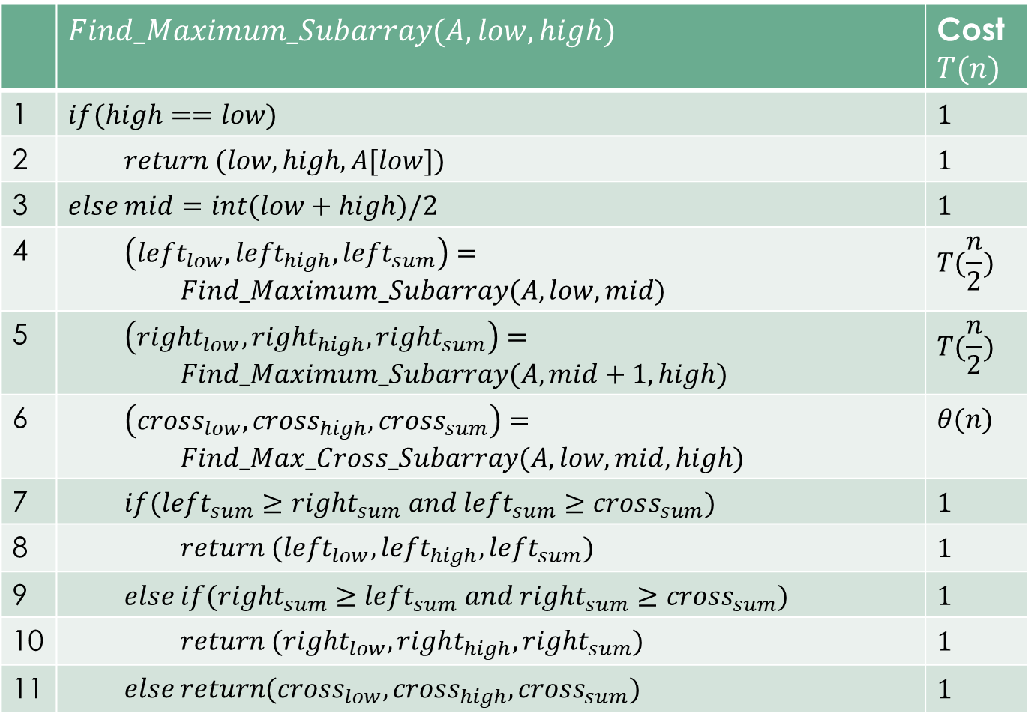

Algorithm Analysis
 | $$Find_Maximum_Subarray(A,low,high)$$ | Cost $T(n)$
1 | $$if(high==low)$$ | $$1$$
2 | $$return (low,high, A[low])$$ | $$1$$
3 | $$else mid=int(low+high)/2$$ | $$1$$
4 | $$\left(left_{low},left_{high},left_{sum}\right)=$$ $$Find_Maximum_Subarray(A,low,mid)$$ | $$T(\frac{n}{2})$$
5 | $\left(right_{low},right_{high},right_{sum}\right)=$ $$Find_Maximum_Subarray(A,mid+1,high)$$ | $$T(\frac{n}{2})$$
6 | $$\left(cross_{low},cross_{high}, cross_{sum}\right)=$$ $$Find_Max_Cross_Subarray(A,low,mid,high)$$ | $$θ(n)$$
7 | $$if(left_{sum}≥right_{sum} and left_{sum}≥cross_{sum})$$ | $$1$$
8 | $$return (left_{low},left_{high},left_{sum})$$ | $$1$$
9 | $$else if(right_{sum}≥left_{sum} and right_{sum}≥cross_{sum})$$ | $$1$$
10 | $$return (right_{low},right_{high},right_{sum})$$ | $$1$$
11 | $$else return(cross_{low},cross_{high}, cross_{sum})$$ | $$1$$
$T\left(n\right)=1+1+1+T\left(\frac{n}{2}\right)+T\left(\frac{n}{2}\right)+θ(n)+1+1+1+1$
$T\left(n\right)=2T\left(\frac{n}{2}\right)+θ\left(n\right)+7$
$T\left(n\right)=2T\left(\frac{n}{2}\right)+θ\left(n\right)$
$T(n)=θ(nlogn)$

Slide 16
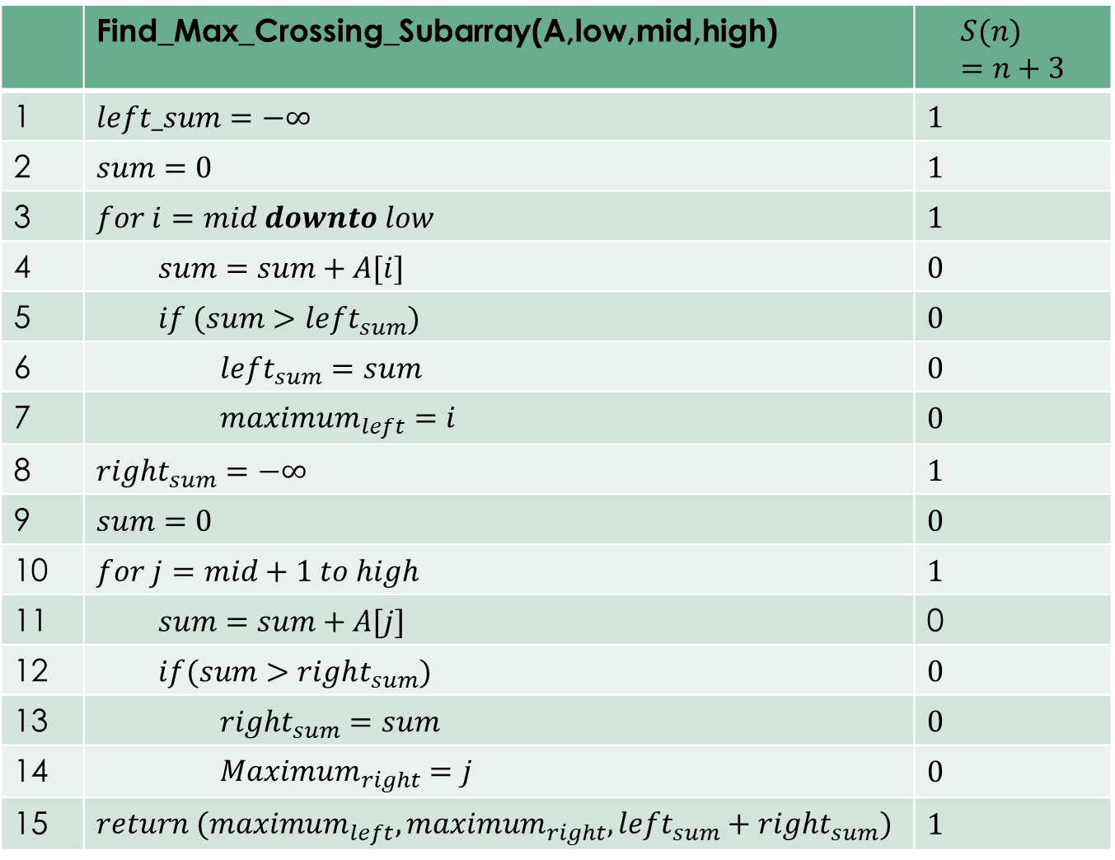

Space Complexity
 | Find_Max_Crossing_Subarray(A,low,mid,high) | $$S(n)=n+3$$
1 | $$left_sum=−∞$$ | $$1$$
2 | $$sum=0$$ | $$1$$
3 | $$for i=mid downto low$$ | $$1$$
4 | $$sum=sum+A[i]$$ | $$0$$
5 | $$if (sum>left_{sum})$$ | $$0$$
6 | $$left_{sum}=sum$$ | $$0$$
7 | $$maximum_{left}=i$$ | $$0$$
8 | $$right_{sum}=−∞$$ | $$1$$
9 | $$sum=0$$ | $$0$$
10 | $$for j=mid+1 to high$$ | $$1$$
11 | $$sum=sum+A[j]$$ | 0
12 | $$if(sum>right_{sum})$$ | $$0$$
13 | $$right_{sum}=sum$$ | $$0$$
14 | $$Maximum_{right}=j$$ | $$0$$
15 | $$return (maximum_{left},maximum_{right},left_{sum}+right_{sum})$$ | $$1$$
$S\left(n\right)=n+3+6$
$S\left(n\right)=n+9$
$S\left(n\right)=n$

Slide 17
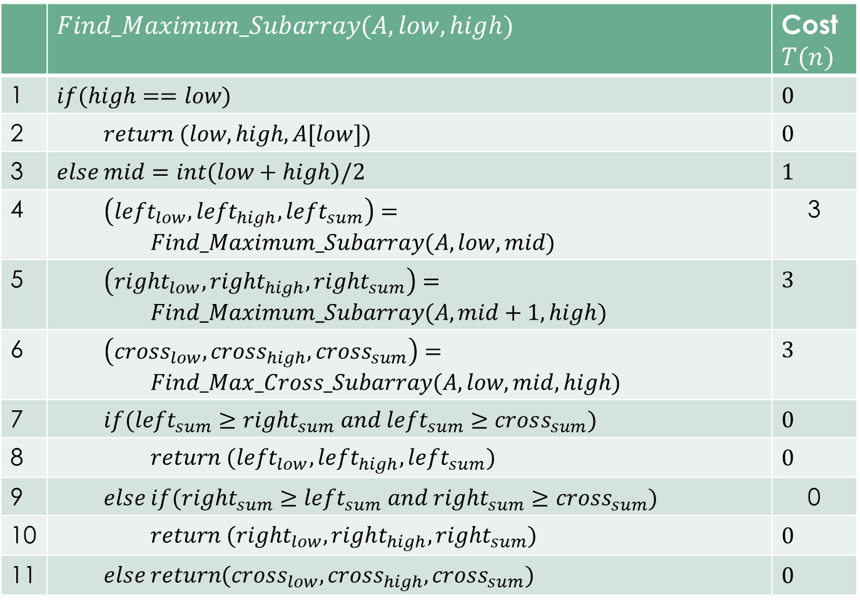

Space Complexity
 | $$Find_Maximum_Subarray(A,low,high)$$ | Cost $T(n)$
1 | $$if(high==low)$$ | $$0$$
2 | $$return (low,high, A[low])$$ | $$0$$
3 | $$else mid=int(low+high)/2$$ | $$1$$
4 | $$\left(left_{low},left_{high},left_{sum}\right)=$$ $$Find_Maximum_Subarray(A,low,mid)$$ | 3
5 | $\left(right_{low},right_{high},right_{sum}\right)=$ $$Find_Maximum_Subarray(A,mid+1,high)$$ | $$3$$
6 | $$\left(cross_{low},cross_{high}, cross_{sum}\right)=$$ $$Find_Max_Cross_Subarray(A,low,mid,high)$$ | $$3$$
7 | $$if(left_{sum}≥right_{sum} and left_{sum}≥cross_{sum})$$ | $$0$$
8 | $$return (left_{low},left_{high},left_{sum})$$ | $$0$$
9 | $$else if(right_{sum}≥left_{sum} and right_{sum}≥cross_{sum})$$ | 0
10 | $$return (right_{low},right_{high},right_{sum})$$ | $$0$$
11 | $$else return(cross_{low},cross_{high}, cross_{sum})$$ | $$0$$
$S(n)=n+10$
$S(n)=n$
$S(n)=0$

Slide 18
def find_max_crossing_subarray(A, low, mid, high): left_sum = -10000 sum = 0; max_left,max_right=0,0 for i in range(mid, low , -1): sum = sum + A[i] if (sum > left_sum): left_sum = sum max_left=i right_sum = -1000 sum = 0; for j in range(mid + 1, high): sum = sum + A[j] if (sum > right_sum): right_sum = sum max_right=j return max_left,max_right,max(left_sum + right_sum, left_sum, right_sum)

Slide 19
def find_maximum_subarray(A, low, high): # Base Case: Only one element if (low == high): return low,high,A[low] mid = (low + high) // 2 left_low,left_high,left_sum=find_maximum_subarray(A, low, mid) right_low,right_high,right_sum=find_maximum_subarray(A, mid + 1, high) cross_low,cross_high,cross_sum=find_max_crossing_subarray(A, low, mid, high) if(left_sum>=right_sum and left_sum>=cross_sum): return left_low,left_high,left_sum elif (right_sum>=left_sum and right_sum>=cross_sum): return right_low,right_high,right_sum else: print(cross_low,cross_high,cross_sum) return cross_low,cross_high,cross_sum

Slide 20
# Driver Code # 0 1 2 3 4 5 6 7 8 9 10 11 12 13 14 15 A = [-13,-3,-25,20,-3,-16,-23,18,20,-7,12,-5,-22,15,-4,7] n = len(A) low,high,max_sum = find_maximum_subarray(A, 0, n - 1) print("Maximum contiguous sum is ", low+1,high+1,max_sum)

Slide 21

Thanks for watching
Dr. Sajid Iqbal
Assistant Professor
Department of Computer Science
Bahauddin Zakariya University, Multan
sajidiqbal.pk@gmail.com
YouTube Channel: COMEDXD
Allah Hafiz

Slide 22
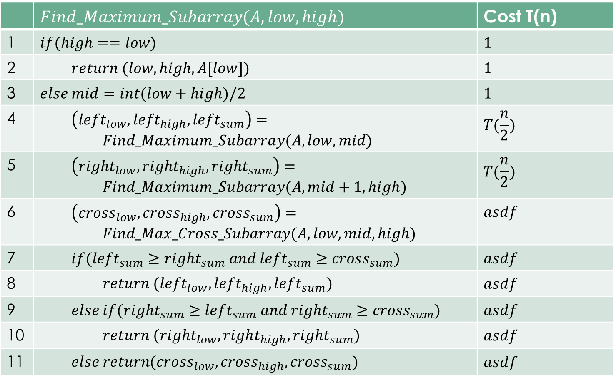
 | $$Find_Maximum_Subarray(A,low,high)$$ | Cost T(n)
1 | $$if(high==low)$$ | $$1$$
2 | $$return (low,high, A[low])$$ | $$1$$
3 | $$else mid=int(low+high)/2$$ | $$1$$
4 | $$\left(left_{low},left_{high},left_{sum}\right)=$$ $$Find_Maximum_Subarray(A,low,mid)$$ | $$T(\frac{n}{2})$$
5 | $\left(right_{low},right_{high},right_{sum}\right)=$ $$Find_Maximum_Subarray(A,mid+1,high)$$ | $$T(\frac{n}{2})$$
6 | $$\left(cross_{low},cross_{high}, cross_{sum}\right)=$$ $$Find_Max_Cross_Subarray(A,low,mid,high)$$ | $$asdf$$
7 | $$if(left_{sum}≥right_{sum} and left_{sum}≥cross_{sum})$$ | $$asdf$$
8 | $$return (left_{low},left_{high},left_{sum})$$ | $$asdf$$
9 | $$else if(right_{sum}≥left_{sum} and right_{sum}≥cross_{sum})$$ | $$asdf$$
10 | $$return (right_{low},right_{high},right_{sum})$$ | $$asdf$$
11 | $$else return(cross_{low},cross_{high}, cross_{sum})$$ | $$asdf$$

